Slide 1
National Association of Home Builders
In Support of Appeal of CE217 Parts I and II and RE147
(Scope and Intent)
ICC APPEAL HEARINGS | September 3, 2020
NAHB Representatives:
Gerald M. Howard
S. Craig Drumheller
Presentation of Appeal by:
Megan H. Berge
Baker Botts L.L.P.

Slide 2
Presentation Overview
Board of Appeals Review
Summary of Issues
  IECC’s Scope and Intent
  CE217 Parts I and II
  RE147
Procedural Implications
  CP#28-05 does not allow proposals to change plumbing codes to be in fire codes

Slide 3
Board of Appeals Review
Scope of Review (6.3.7):
  Includes “Matters of process and procedure”
  Excludes “decisions on the relative merits of technical matters”
Basis for Action (6.3.8):
  Any “material and significant irregularity of process or procedure”
Allowed Actions (6.3.9):
  Board of Appeals may “fashion any remedy it deems appropriate”

Slide 4
Summary of Issues
IECC’s scope and intent is limited to energy improvements of the building itself.
CE217 Parts I and II fall outside IECC’s scope and intent because they promote electric cars.
RE147 does not meet IECC’s scope and intent because energy conservation hinges entirely on the future choice to switch fuels.
Even if they may be good ideas, do they belong in the IECC?

Slide 5
IECC’s scope and intent is limited to direct energy improvements of the building itself.

Slide 6
C101.3 and R101.3
“This code shall regulate the design and construction of buildings for the effective use and conservation of energy over the useful life of each building. This code is intended to provide flexibility to permit the use of innovative approaches and techniques to achieve this objective. This code is not intended to abridge safety, health or environmental requirements contained in other applicable codes or ordinances.”
The “effective use and conservation of energy” must be accomplished by each building

Slide 7
“But our proposals regulate building design and construction, and they will improve energy use!”
Energy improvements that occur as an effect of the proposal is not a sufficient reason to include it in the IECC
  No limiting principle
  The definition of “for”
  The phrase “over the useful life of each building”
  Comparison with other International Codes and the failed attempts to change C101.3 and R101.3

Slide 8
1. Open Invitation for Any Building Code
Almost every action in people’s lives affect the use and conservation of energy
  Food
  Waste
  Travel
  Consumption
  Family size
“Every new building must include a garden so that inhabitants can locally source their food and reduce the long-distance, fuel-intensive transportation of food”

Slide 9
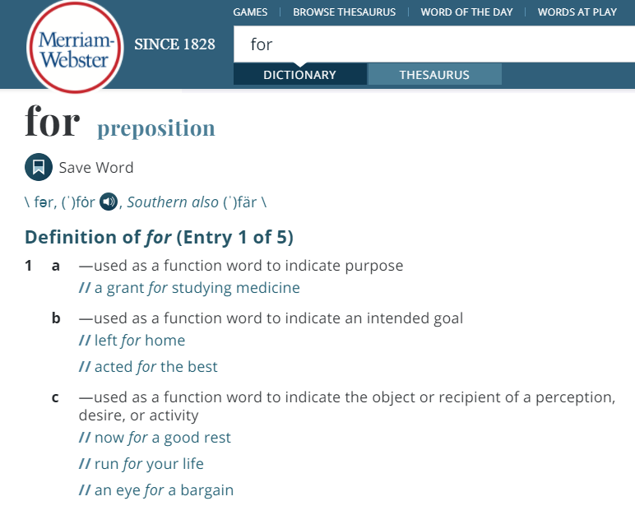
2. “For” Means a Direct Relationship
“This code shall regulate the design and construction of buildings for the effective use and conservation of energy over the useful life of each building.”
Direct relationship between the action and purpose ≠ action that merely affects the purpose
    “I received a grant for studying medicine”
    “This law shall regulate goods produced for commerce”

Slide 10
3. “Over the Useful Life of Each Building”
“This code shall regulate the design and construction of buildings for the effective use and conservation of energy over the useful life of each building.”
If proposals improve energy use beyond the building’s structure, the phrase becomes superfluous (and obsolete)
Example: EV parking spaces → EVs → Replacement of the fossil fuel car → Energy conservation
  Energy conservation occurs regardless of the useful life of the building

Slide 11
4. Drafting History and Comparison
International Green Construction Codes:
  101.2.1 (1.1): “The purpose of this code is to . . . reduce emissions from buildings and building systems; . . . protect local biodiversity and ecosystem services . . . .”
  101.3.1 (2.1): “This code contains requirements that address site sustainability . . . .”
    301.2 (3.2): “Site: a contiguous area of land that is under the ownership or control of one entity.”
Attempts were made to broaden the scope and intent of the IECC and all of them failed
  CE1 (“sites”), CE3 (“systems”), CE5 (“life safety”), CE6 (“human comfort”), ADM10 (“general welfare”)
Over ten years of consistent understanding of the scope and intent

Slide 12
CE217 Parts I and II fall outside IECC’s scope and intent because they promote electric cars.

Slide 13
Quick Summary of CE217 Parts I and II
Newly constructed buildings shall provide:
  EV Ready Spaces
  EV Capable Spaces
Generally to incentivize EVs by providing EV charging infrastructure in new buildings

Slide 14
Attenuated and Indirect Relationship with IECC:
At Best, Probabilistic
Effective use and conservation of energy is a possible effect, but the proposal alone does not accomplish the goal
  Comparison: Improved heating insulation in buildings
Series of assumptions that must all be true demonstrates the tangential relationship between CE217 and the IECC
  Will the person need an EV and purchase one?
  Does the EV displace regular cars?
  Does the EV incentivize more driving, leading to more energy use?

Slide 15
The Building’s Energy Use Increases
Compare:
  Status quo: Cannot charge EVs in building = Cannot use energy in the building to charge EVs
  CE217: Can, and will charge EVs in the building = Energy use in the building increases to charge EVs
Building codes intended to regulate buildings for the conservation of energy would allow increasing energy consumption of the building?

Slide 16
RE147 falls outside IECC’s scope and intent because energy conservation hinges entirely on the resident’s future choice to switch appliance fuel sources.

Slide 17
Quick Summary of RE147
Electric circuits and receptacles near the building’s gas/propane water heater, dyer, or cooking equipment
Preserve indoor space near the water heater (in case an electric water heater gets installed)
If the resident decides to switch to electric appliances (from gas) for whatever reason, RE147 helps
  Reason does not have to be for energy conservation or effective use of energy

Slide 18
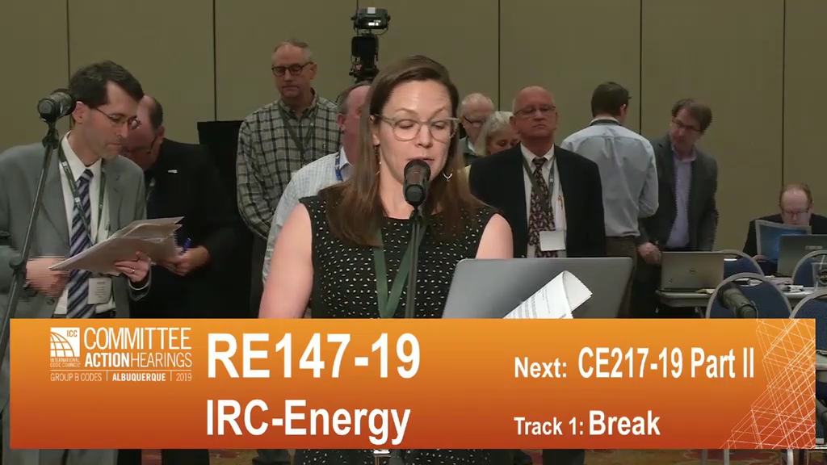
Advocates Admit That RE147 is for “Consumer Choice in the Future”

Slide 19
A Building Code Entirely Dependent on a Person’s Future Life Decision
If the resident decides to switch to electric appliances, RE147 assists in that transition
  Effective use and conservation of energy will never occur from the proposal without the building inhabitant’s decision
  Entirely hypothetical energy savings

Slide 20
Procedural Implications
Does CP#28-05 allow:
Proposals to change the International Fuel Gas Code to be in the International Swimming Pool and Spa Code?
Committee for the International Zoning Code to deliberate amending the International Mechanical Code?

Slide 21
CP#28-05, Rules of Procedure
Form and Content of Code Change Submittals (3.3):
  “Each submittal shall contain the following information:”
  “3.3.2 Code Reference: Each code change proposal shall relate to the applicable code sections(s) in the latest edition of the Code.”
Referenced Standards (3.6):
  “In order for a standard to be considered for reference or to continue to be referenced by the Codes, a standard shall meet the following criteria.”
  “3.6.2.2 The standard shall be appropriate for the subject covered.”
Proposals must match the appropriate International Code

Slide 22
CP#28-05, Rules of Procedure (Cont.)
Code Publication (1.3):
  “The ICC Board of Directors (ICC Board) shall determine the title and the general purpose and scope of each Code published by the ICC.”
Submittal of Code Change Proposals: Intent (3.1):
  “Any interested person. . . may submit a code change proposal which will be duly considered when in conformance to these Rules of Procedure.”
Incomplete Code Change Proposals (4.3):
  “When a code change proposal is submitted . . . without the required information or judged as not in compliance with these Rules of Procedure, . . . the proposal shall be held until the deficiencies are corrected . . . .”
Standard Promulgation: Proposed New Standards (3.6.3.1.1):
  “The code change proposal shall be considered at the Committee Action Hearing by the applicable code development committee responsible for the corresponding proposed changes to the code text.”
Proposals that do not belong → No consideration, no final votes, no adoption

